Slide 1


Slide 2
APPLIED PHYSICS LAB
MUHAMMAD ATTIQ UR REHMAN
ABDUL RAHEEM
HASSAM KHAN
ZIA UL ISLAM
ASHFAQ AHMAD
DCSE
SECTION B.

Slide 3
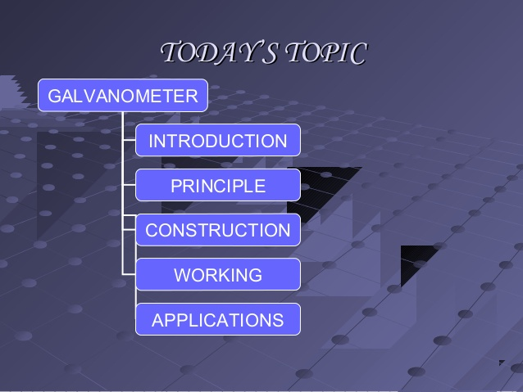

Slide 4
GALVANOMETER
Electromechanical device
Detect small amount of current & voltage
Modern galvanometer are called ARSONVAL GALVANOMETER

Slide 5
HISTORY
JOHANN SCHEIGGER
AT UNIVERSITY OF HALLE
16 SEPTEMBER 1820
AMPERE CONTRIBUTED IN IT

Slide 6
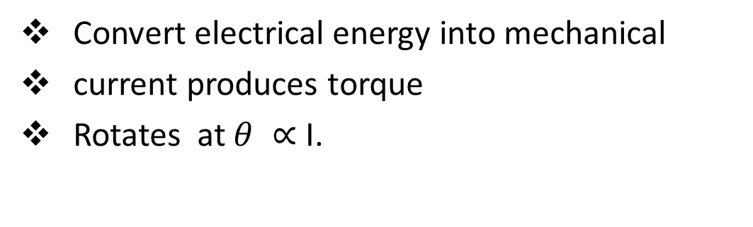
PRINCIPLE
Convert electrical energy into mechanical
current produces torque
Rotates at $θ ∝$ I.

Slide 7
construction
A U Shaped permanent magnet with concave poles
Flat rectangular coil of wire
A Soft Iron cylinder
A pointer
Scale

Slide 8
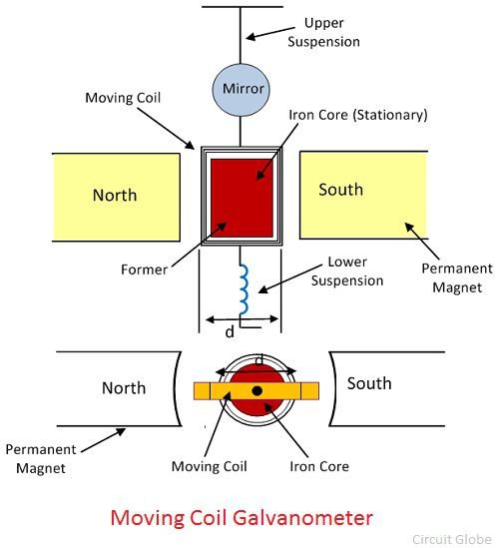
DIAGRAM

Slide 9
WORKING
Solenoid creates magnetic field when current through
The magnetic field tries to line up with permanent magnets fields
Move pointer in the process
More current , more pointer moves.

Slide 10
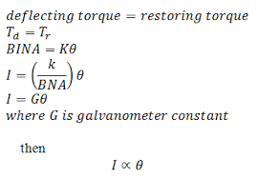
EQUATIONS

Slide 11


Slide 12
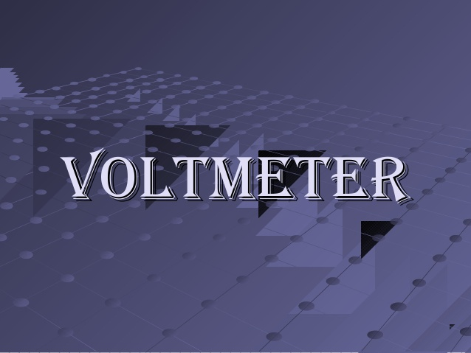

Slide 13
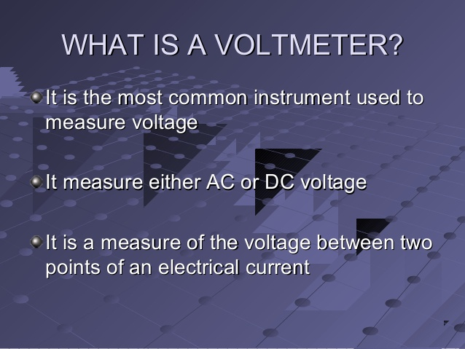

Slide 14
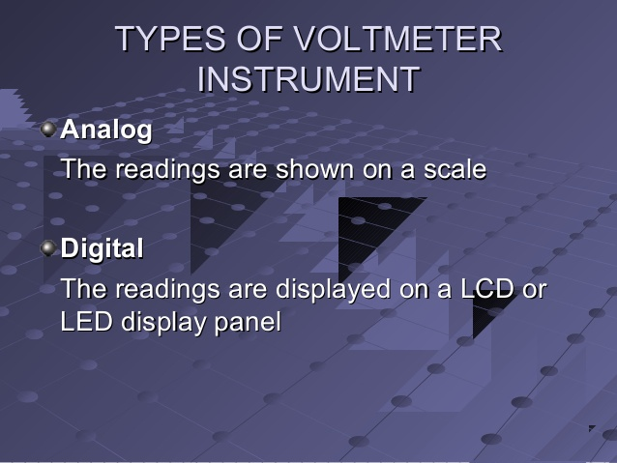

Slide 15
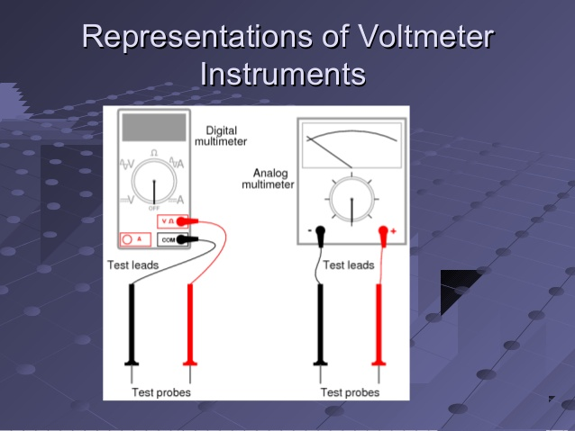

Slide 16
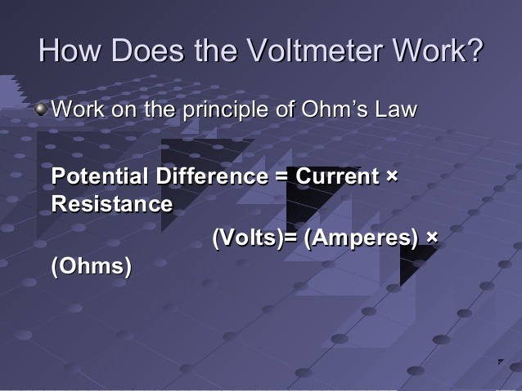

Slide 17
LIMITATIONS
Increasing the area of the coil beyond limit makes the instrument bulky
Increasing the strength of magnetic induction leads to increase in the weight of apparatus.

Slide 18


